Slide 1
How to use EBSCOhost Database

Slide 2

Library Home Page
https://lib.pu.edu.tw
Choose Language

Slide 3
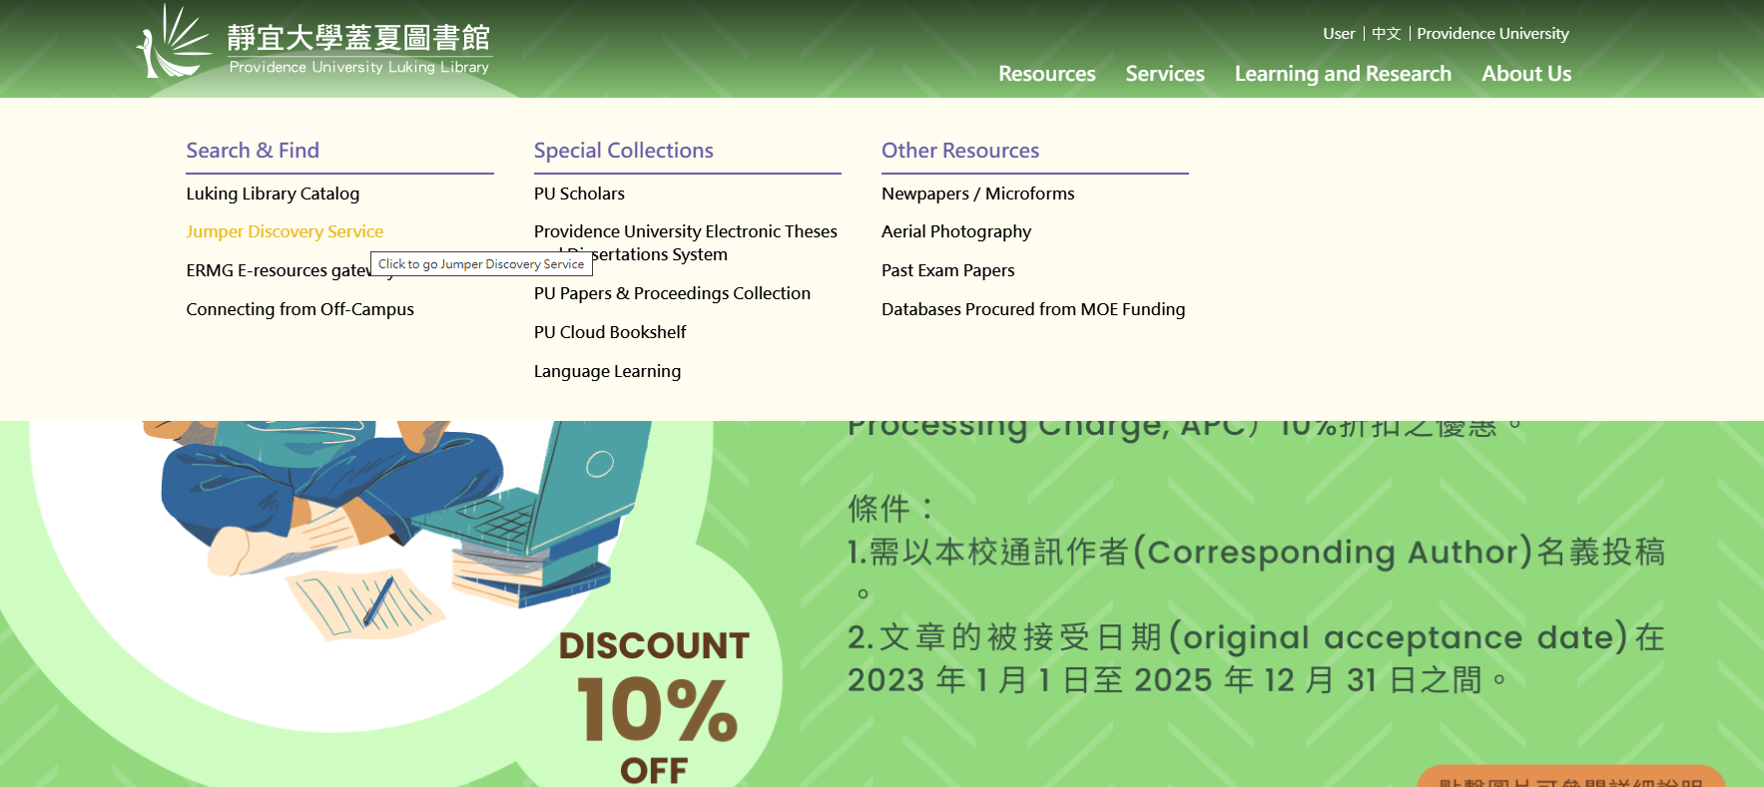
1.
2.

Slide 4
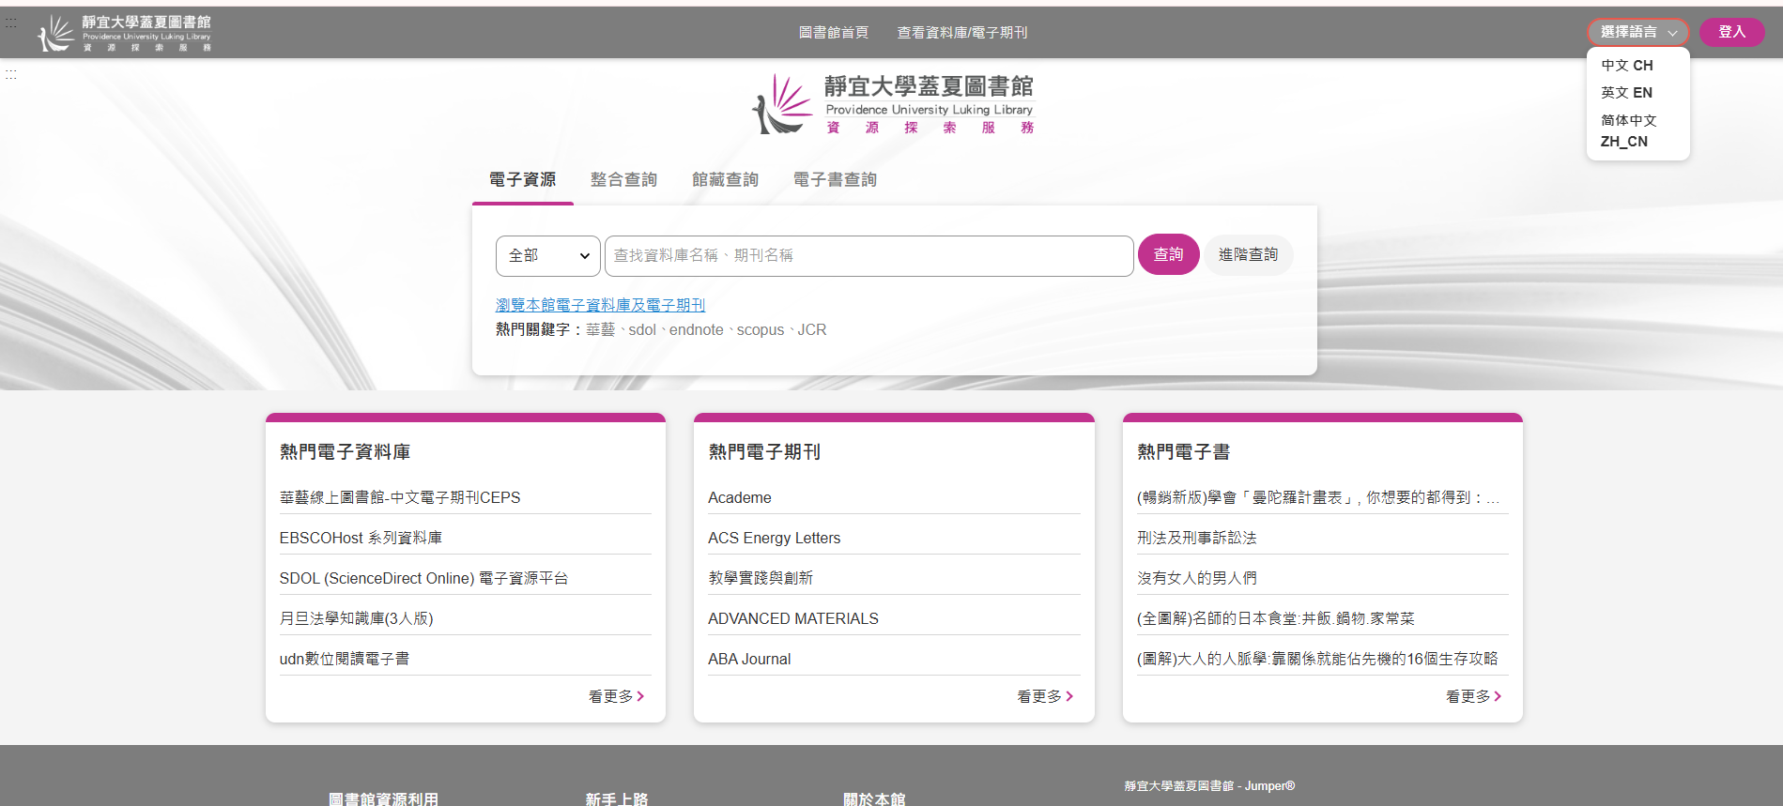
Language Switch
Choose Language

Slide 5
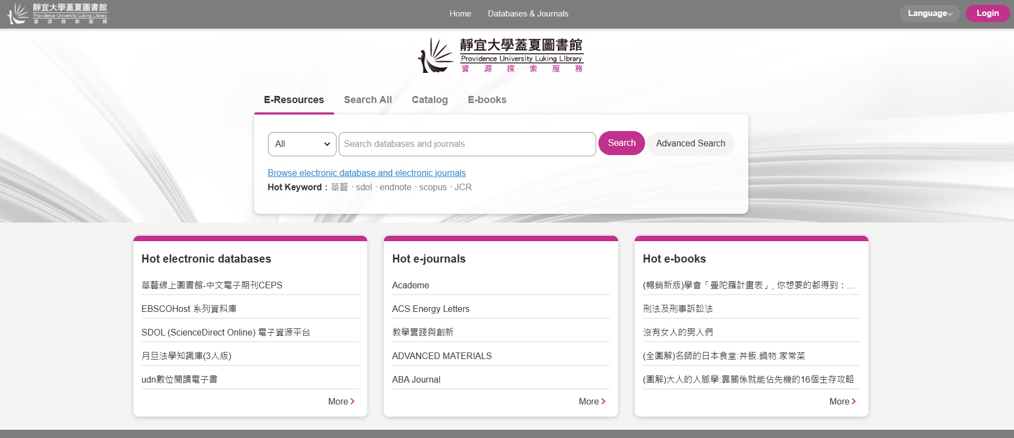
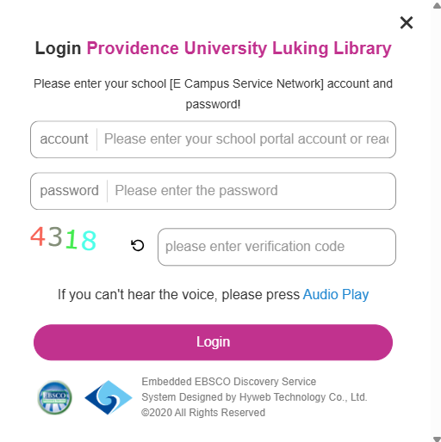
Login to System

Slide 6
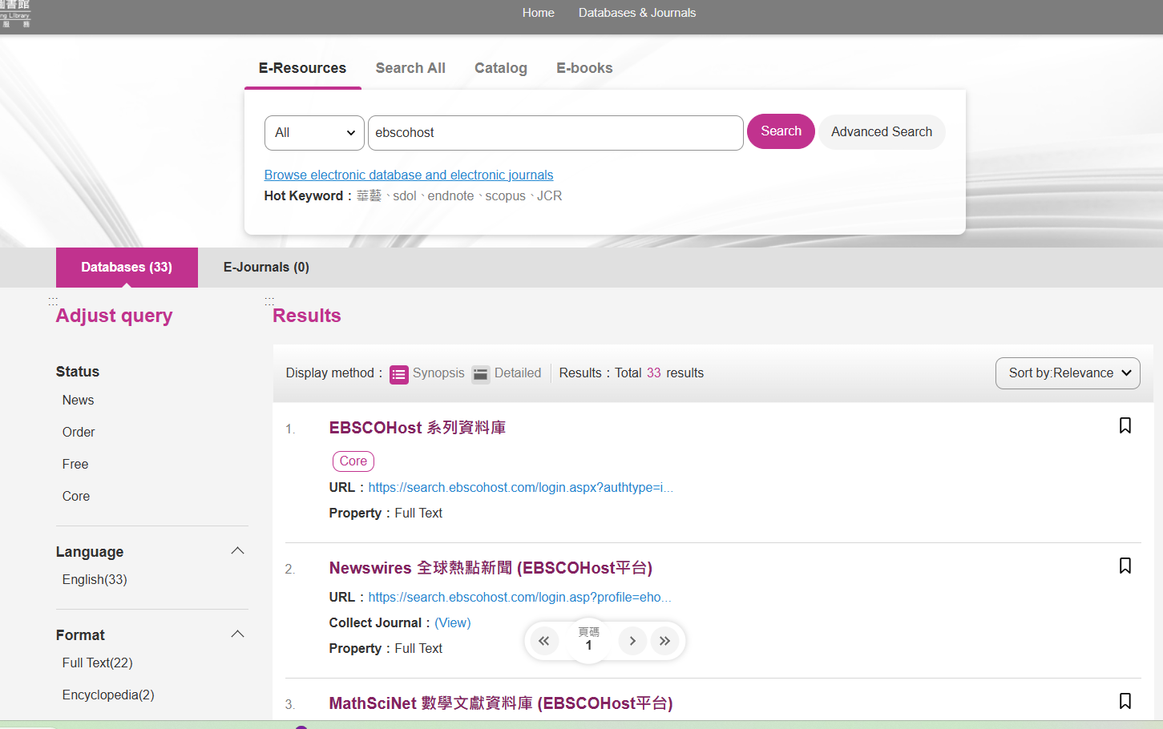
Search the Database
1.
2.
Enter the database name
3.
Click the link

Slide 7
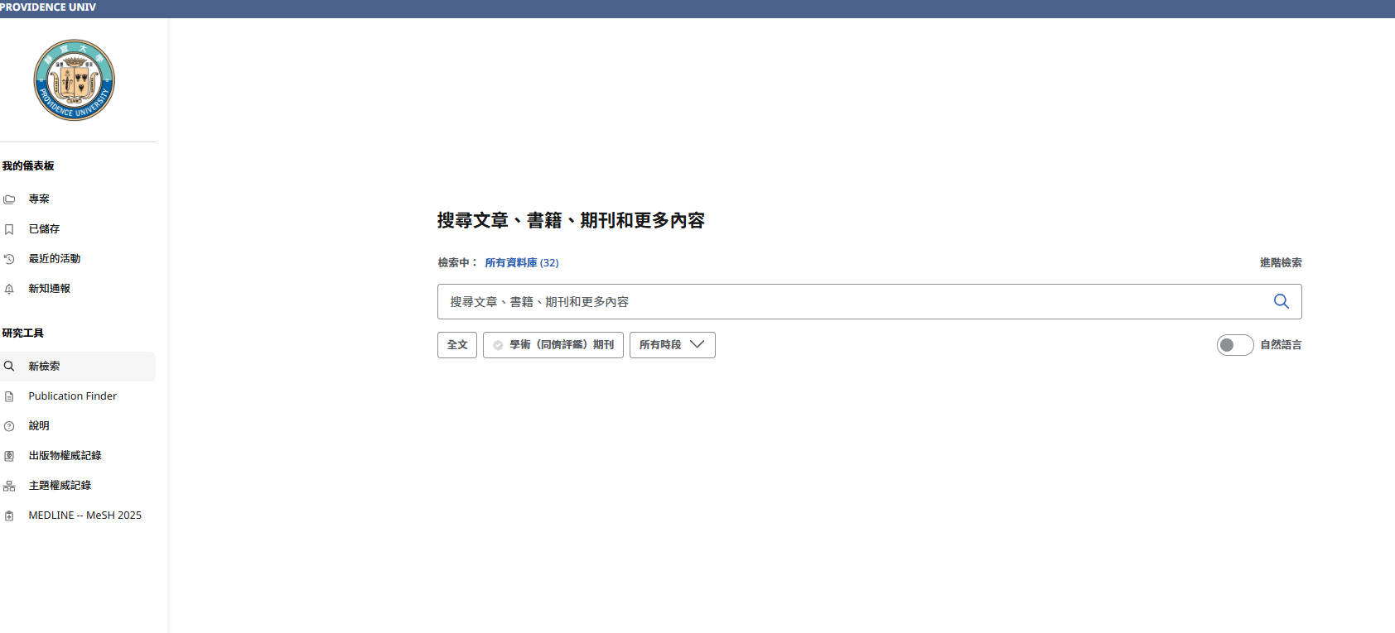
Chinese Webpage

Slide 8
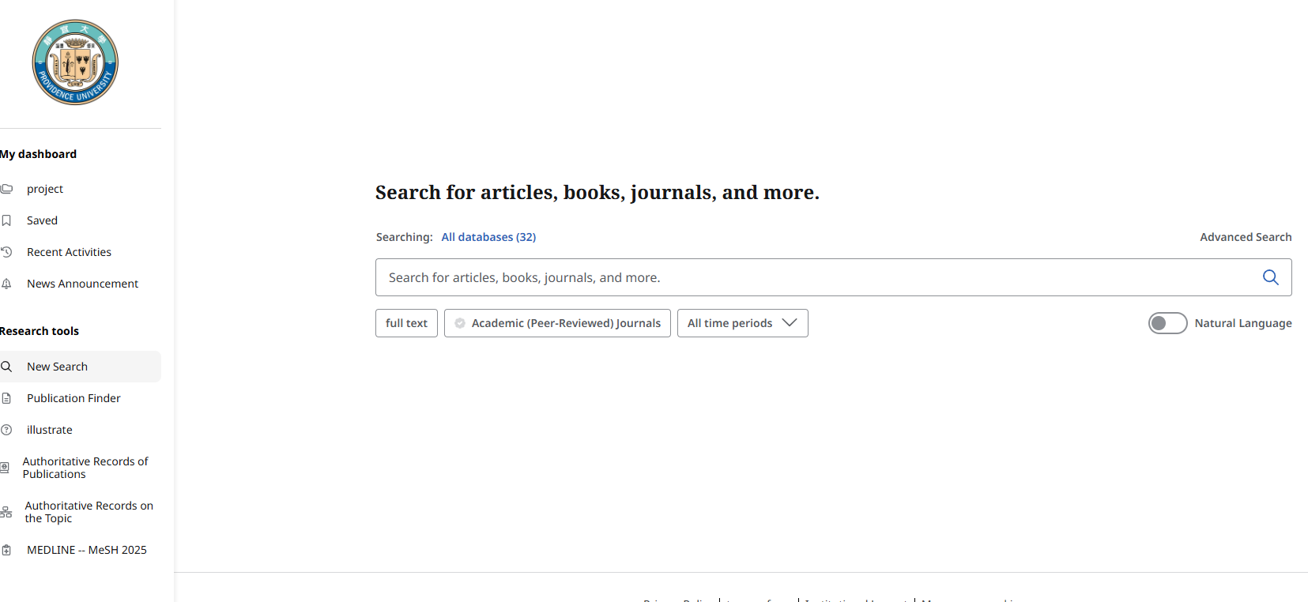
Translate into English on the Webpage
Data encompassing 32 databases
Enter keywords to search the system

Slide 9
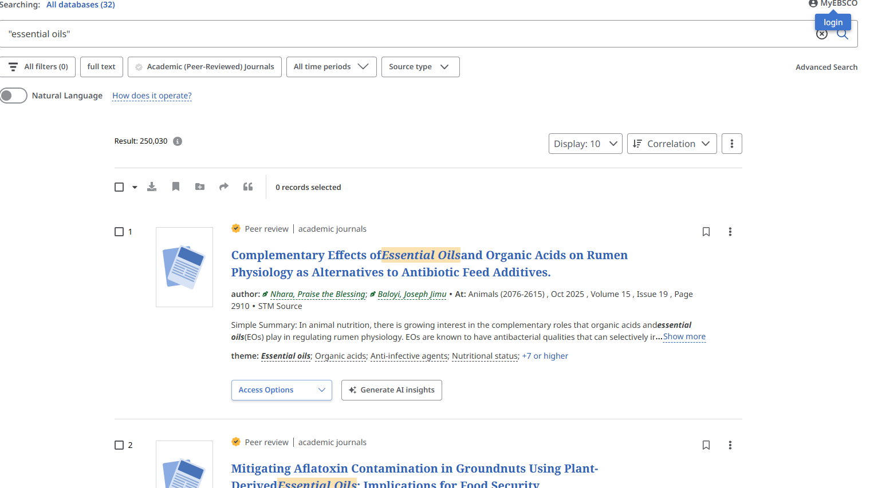
For Example
Keywords
You can apply filters to refine the search results

Slide 10
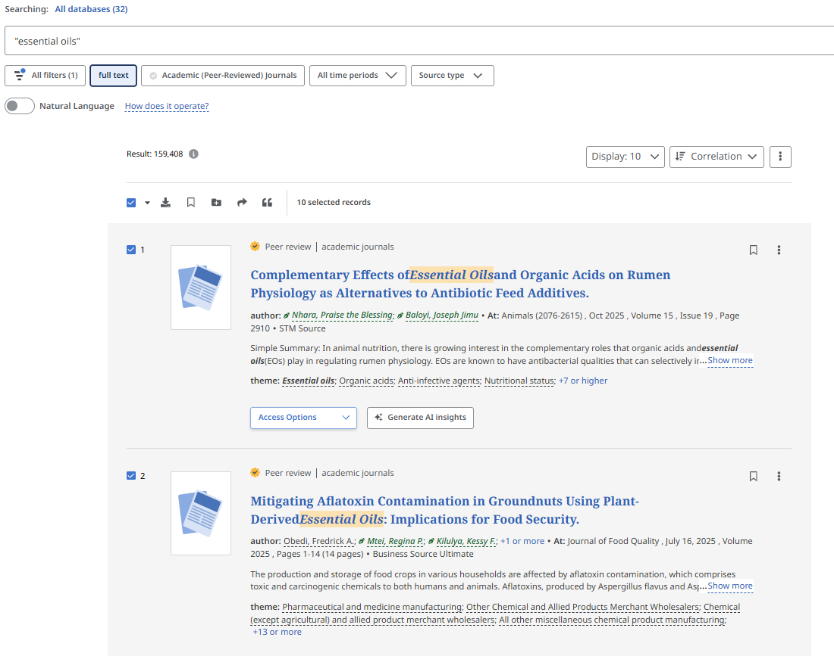
Download bibliography
Select multiple records
citation

Slide 11
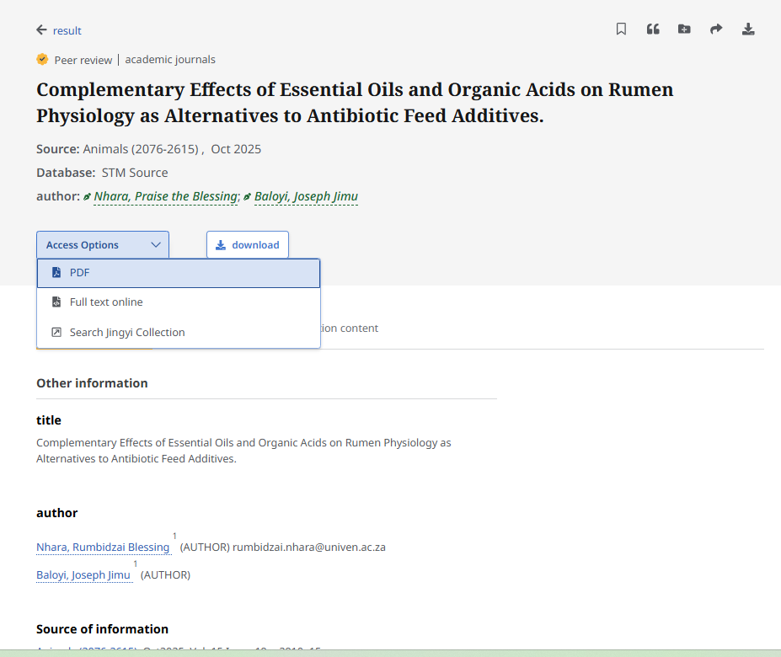
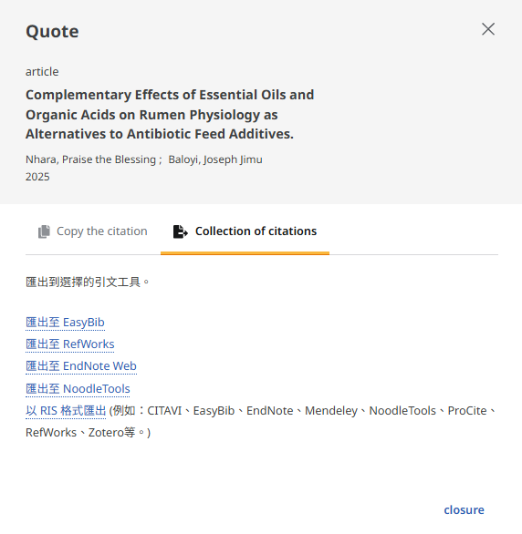
Click a book title to see the book details
citation
Download the full article
Read the full article

Slide 12
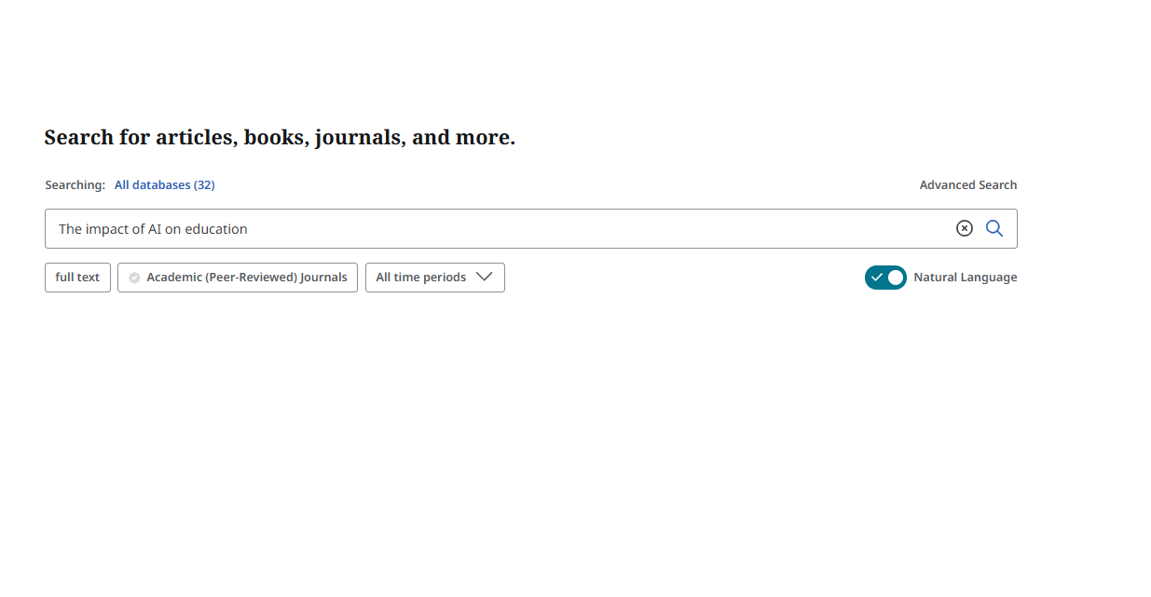
EBSCOhost AI
2.
Enter your question
1.

Slide 13
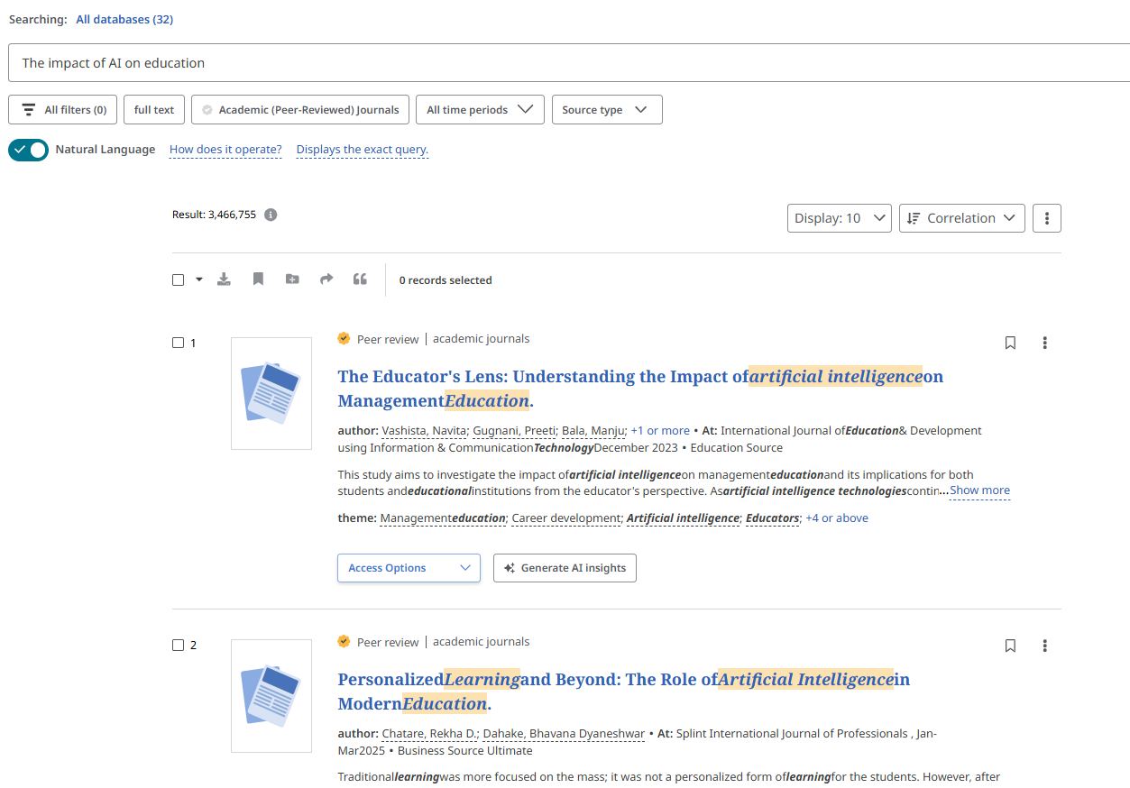


Slide 14
END

